Slide 1
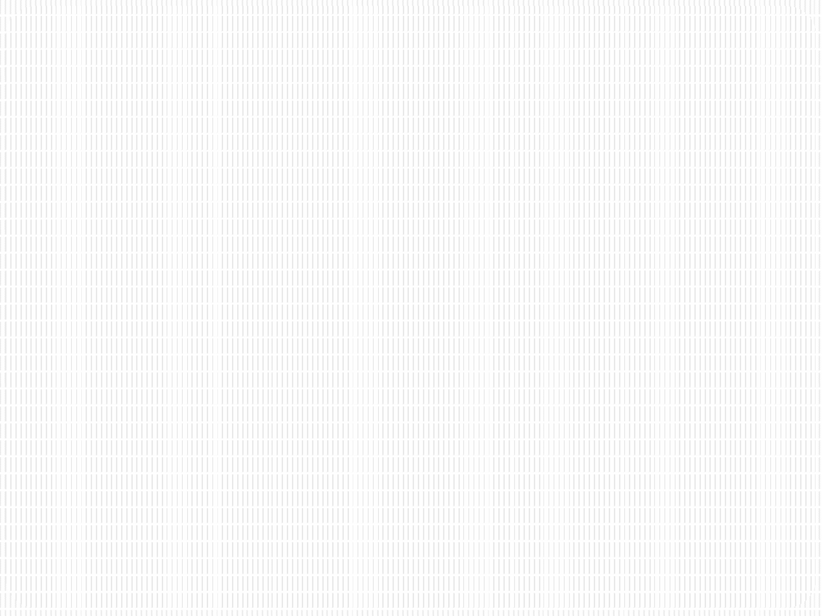


SRM INSTITUTE OF SCIENCE AND TECHNOLOGY
18CSC201J – Data Structures and Algorithms
Unit III- STACK & QUEUE

Slide 2
Session 7

Slide 3
Applications of Recursion: Towers of Hanoi
Towers of Hanoi Problem:
There are 3 pegs and n disks. All the n disks are stacked in 1 peg in the order of their sizes with the largest disk at the bottom and smallest on top. All the disks have to be transferred to another peg.
Rules for transfer:
Only one disk can be moved at a time.
Each move consists of taking the upper disk from one of the stacks and placing it on top of another stack i.e. a disk can only be moved if it is the uppermost disk on a stack.
No disk may be placed on top of a smaller disk.

Slide 4
Towers of Hanoi
Initial Position:
All disks from peg A have to be transferred to peg C
A B C

Slide 5
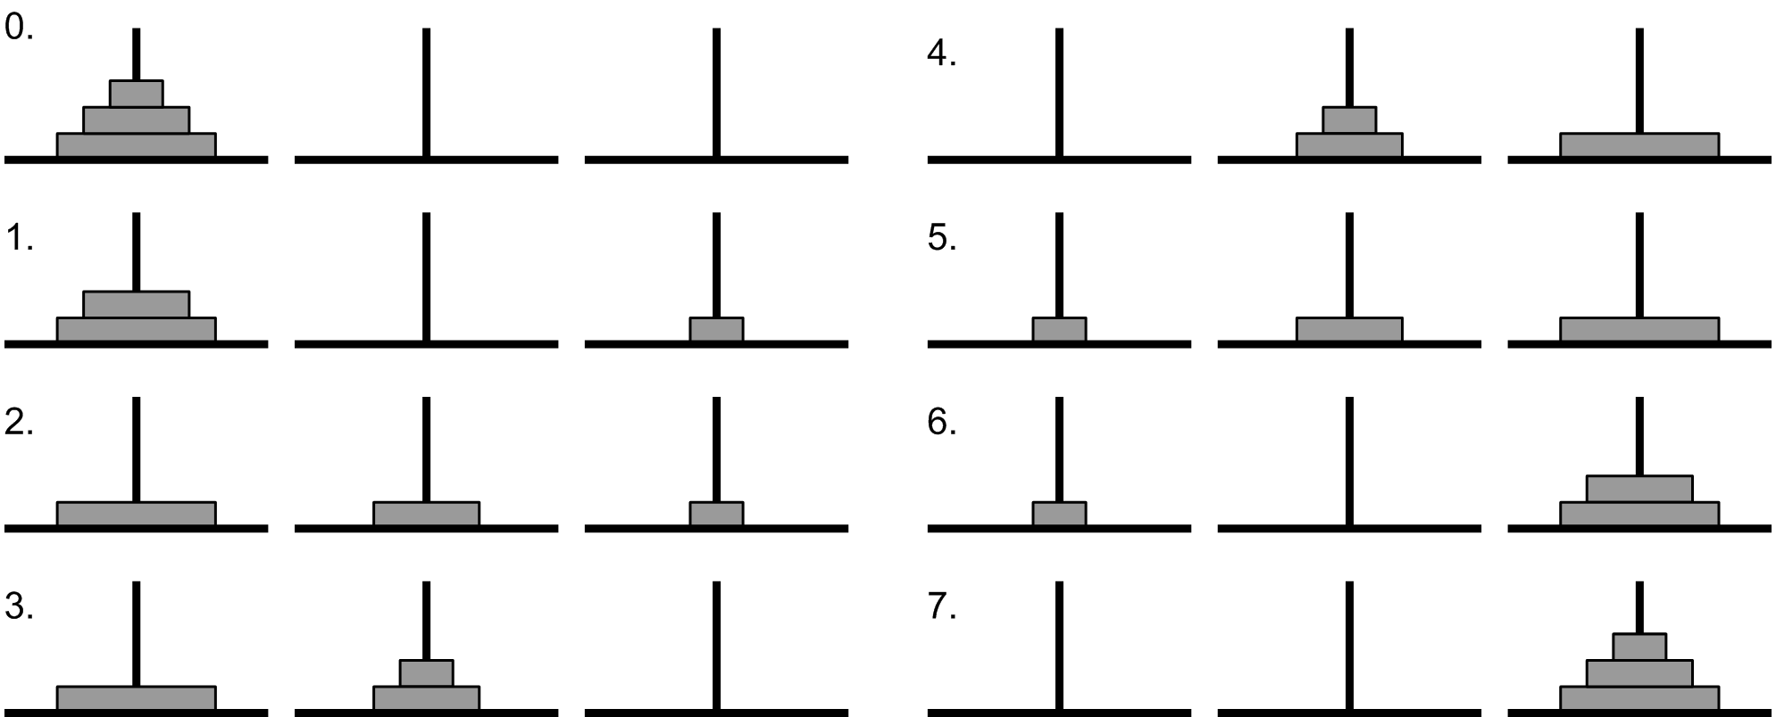
Towers of Hanoi Solution for 3 disks
Image Source: https://www.includehelp.com/data-structure-tutorial/tower-of-hanoi-using-recursion.aspx

Slide 6
Towers of Hanoi – Recursive Solution
/* N = Number of disks
Beg, Aux, End are the pegs */
Tower(N, Beg, Aux, End)
Begin
if N = 1 then
Print: Beg --> End;
else
Call Tower(N-1, Beg, End, Aux);
Print: Beg --> End;
Call Tower(N-1, Aux, Beg, End);
endif
End

Slide 7
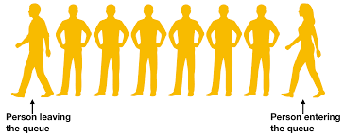
The Queue ADT
With a queue, insertion is done at one end whereas deletion is performed at the other end.
It is a First In First Out (FIFO) Structure. That is, the first element to enter into the queue will be the first element to get out of the queue.
Front
Rear
Image Source: https://www.codesdope.com/course/data-structures-queue/

Slide 8
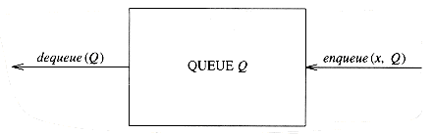
The basic operations on a Queue
Enqueue: inserts an element at the end of the list (called the rear)
Dequeue: deletes (and returns) the element at the start of the list (called the front).
Peek: Get the front element

